Slide 2
Did you know, that…
… viadonau locks through more than
90,000 vessels per year?
… viadonau takes charge of 250 kilometres of asphalted cycle tracks?
… the flood protection facilities
between Vienna and the
Slovakian border protect more than 600,000 inhabitants?
… between 9 and 12 million tons of goods are transported every year on the Austrian stretch of the Danube?
… viadonau ensures the preservation of 500 kilometres of towpaths?
… viadonau cares for 800 kilometres
of riverbank?
… viadonau manages 300 kilometres of flood protections facilities?
… one inland vessel transports a ton of goods 4 times further than a truck, but with the same expenditure of energy?
… over 300 bird species are native along the river Danube?
… viadonau manages 15,000 hectares of real estate?

Slide 3
Flood Management Activities of viadonau
Bad Deutsch-Altenburg, 14. November 2017

Slide 4
Agenda
Overview
Department of Flood Management - Duties and Responsibilities
Flood Emergency Response and Management
Rehabilitation of Flood Protection Facilities

Slide 5
Overview

Slide 6
Have a look at our logistics centre. Directly connected to over 80 million costumers.

Slide 7
This is why 260 employees work along the riverbank of the Danube …

Slide 9
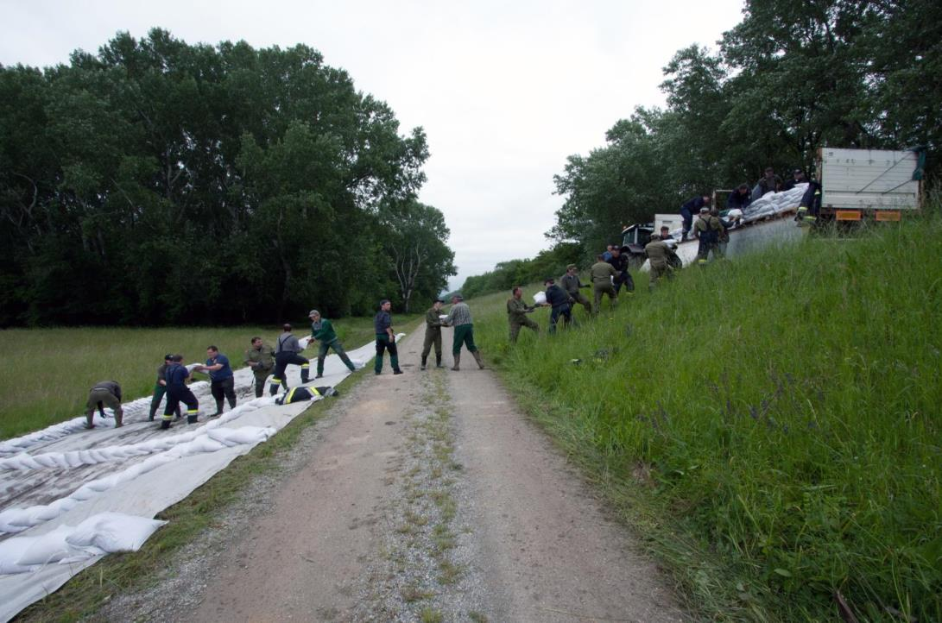

Slide 11
… at the locks…

Slide 15
… on board of vessels …

Slide 17
and in the four service centres Oberes Donautal, Wachau, Carnuntum and March/Thaya as well as in the head office in Vienna.

Slide 18
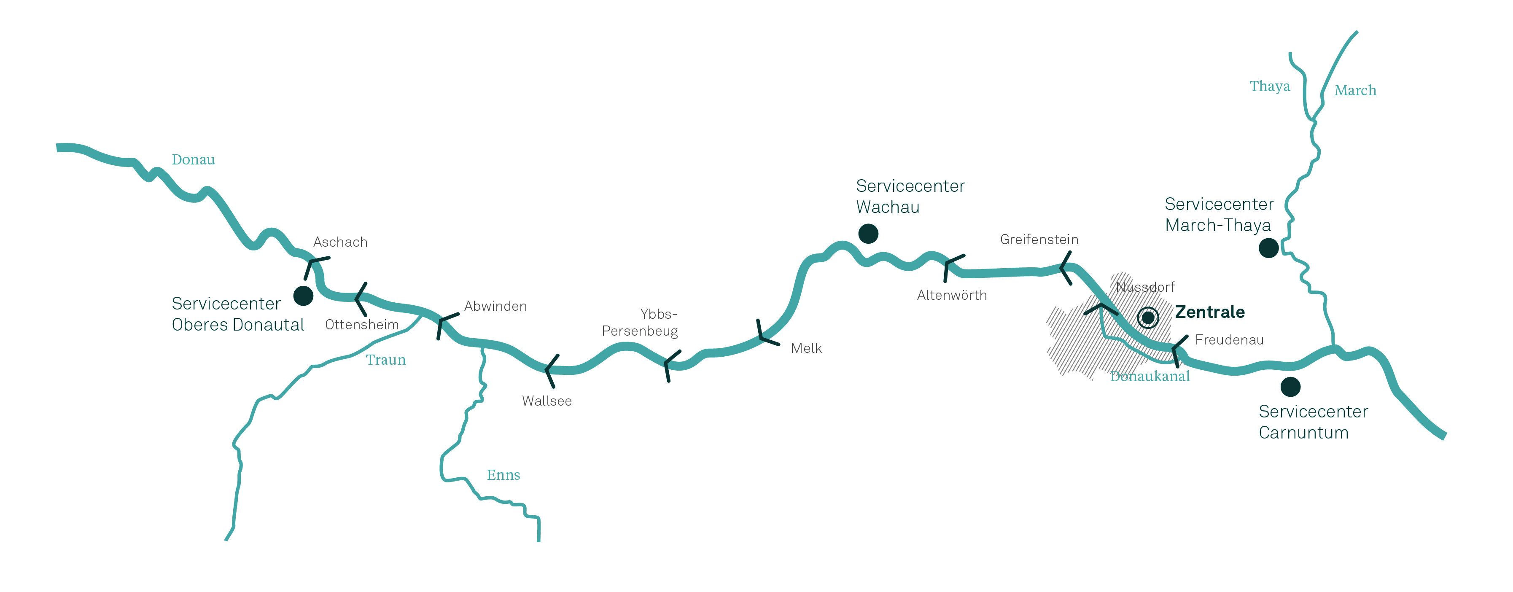
Available for you on 378 kilometres.
via donau – Österreichische Wasserstraßen-Gesellschaft mbH
company owner: Ministry of Transport, Innovation and Technology
founded 2005
about 260 employees
Turnover 2016: ca. 30 million Euros
Notes:
Bild in Englisch !!!

Slide 19
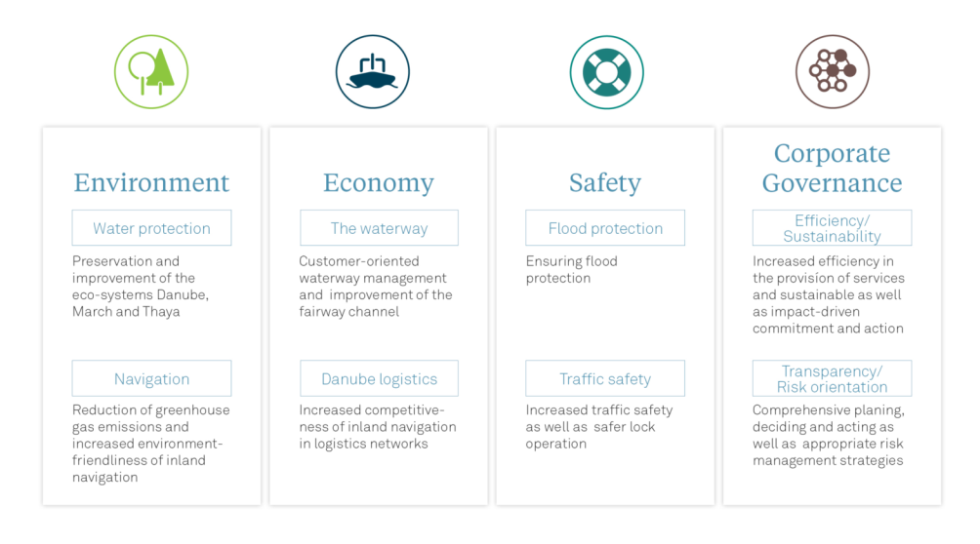
Corporate Objectives - four business pillars

Slide 20
Department of Flood Management Duties and Responsibilities

Slide 21
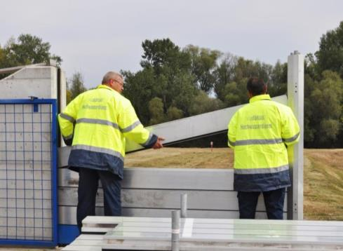
Flood protection
Goal:
Ensuring flood protection

Slide 22
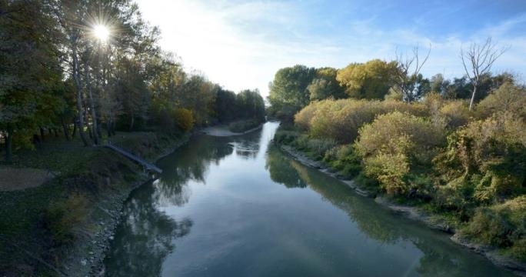
Water protection
Goal:
Preservation and improvement of the eco-systems Danube, Morava and Thaya

Slide 23
Department of Flood Management
Flood protection operations
Implementation of protective and preventive measures for the safe discharge of flood water
Prevention of flood damage
Flood emergency response and management
Flood protection projects
Rehabilitation of flood protection facilities

Slide 24
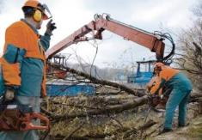
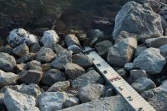
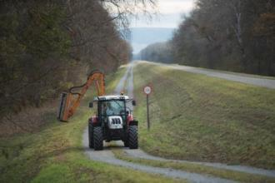
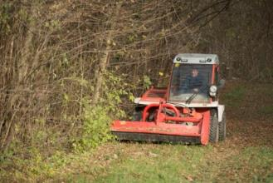
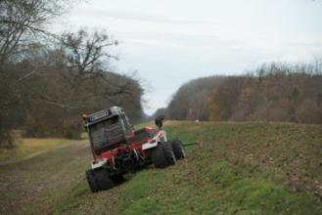
Flood protection operations
Dry weather operations
Day-to-day operation of the flood protection facilities
Maintenance
Regular inspections
Functionality tests
Safety checks

Slide 25
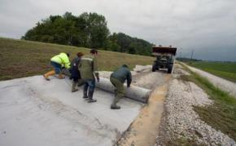
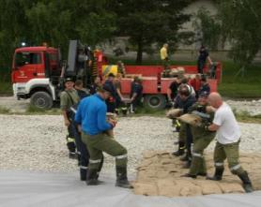
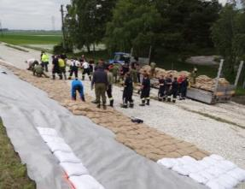
Flood protection operations
Flood emergency response and management
Monitoring of river water levels
Flood emergency response in cooperation with local authorities and emergency services

Slide 26
Flood protection operations
 | Morava and lower Thaya region | Danube region
Client | viadonau is contracted by 2 Flood Protection Associations | Danube Flood Control Agency (bmvit, City of Vienna, Federal State of Lower Austria)
River | Morava Lower Thaya | Danube (in lower Austria and Vienna including the tributaries influenced by the backwater of the Danube)
Flood protection facilities | approx. 75 km | approx. 300 km (observed during flood events: approx. 162 km)
Objects | 65 culverts, sluices and other structures (pumping stations, mobile flood defense systems, …) (65 operated during flood events) | 13 bridges 90 culverts, sluices and other structures (pumping stations, mobile flood defense systems, …) (55 operated during flood events)

Slide 27
Flood protection operations
 | Morava and lower Thaya region | Danube region
Dry Weather Operations | Coordination Supervision The day-to-day operation of the flood protection facilities is carried out by the Flood Protection Associations | Day-to-day operation of the flood protection facilities Maintenance Regular inspections Functionality tests Safety checks
Flood Emergency Response | Coordination Supervision Guard duty and defensive measures are carried out by the local voluntary fire brigade | Guard duty Defensive measures Supported by local voluntary fire brigade and federal armed forces
 | 4 persons active during flood emergency response | 40 persons active during flood emergency response

Slide 28
Flood Emergency Response and Management

Slide 29
Flood emergency response
Organisation
Managing Director viadonau
Head of Flood Emergency Response
Head of Outpost
Head of Outpost
Hydrologist
Guard I
Guard II
Guard I
Guard II
Head of Outpost
Guard I
Guard II

Slide 30
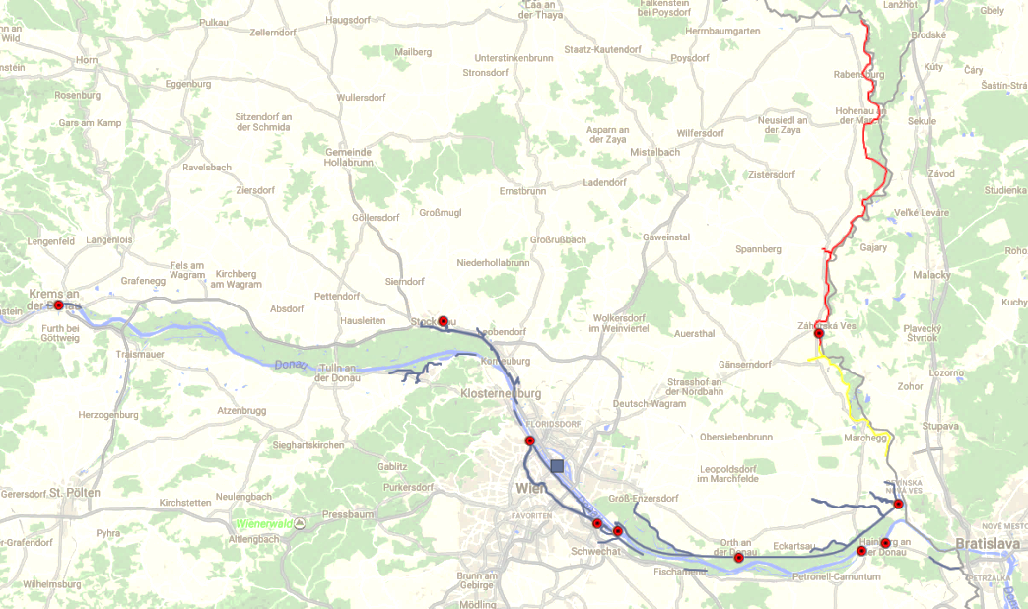
Flood protection operations
Danube: 9 outposts
Morava: 1 outpost
Krems
Stockerau
Angern
Nußdorf
viadonau headquaters
Markthof
Wehr 2
Albern
Orth
Hainburg
Bad Deutsch-Altenburg

Slide 31
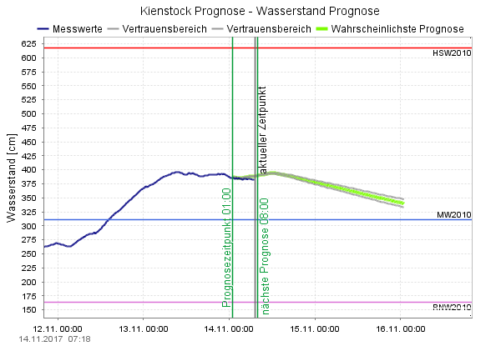
Flood emergency response
Monitoring and Alerting
9 published gauges on the Danube
current water level
deviation to last measurement
low-water forecast : 5 days
published flood forecasting: 2 days (calculated: ~ 3 days)

Slide 32
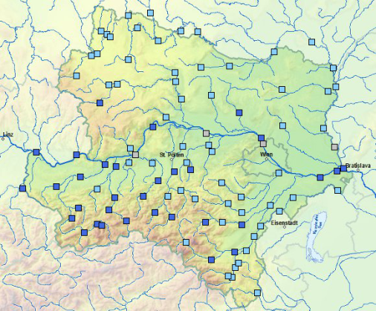
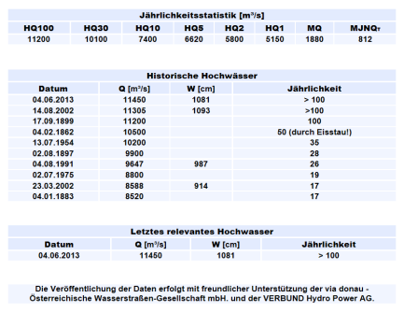
Flood emergency response
Reference gauge for Danube:
KIENSTOCK

Slide 33
Flood emergency response
Stage Model
Flood emergency response depending on water level at reference gauge
The beginning of a stage is defined by the exceedance of a specific water level at reference gauges (upward trend)
Staff schedule for each stage
4 Stages
Early warning stage
Alert
Flood Emergency Response Stage I
Flood Emergency Response Stage II

Slide 34
Flood emergency response
Flood Emergency Response
Stage I
Flood Emergency Response
Stage II
Flood Emergency Response
Stage I
Early Warning Stage
Alert
Alert
Cleanup
Dry weather operations
Flood emergency response
Dry weather operations
850cm
KIEN
900cm
KIEN
800cm
KIEN
750cm
KIEN
700cm
KIEN
650cm
KIEN
500cm
KIEN
Water level
at reference gauge
Time

Slide 35
Flood emergency response
Early Warning Stage
The beginning and end of the early warning stage are determined by the hydrologist on-duty and the head of flood emergency response based on:
Weather forecast
Current water level / Water level forecast
If necessary: Initiation of on-call duty for staff for next stage
Activities:
Monitoring of water levels, weather forecast and water level forecast by the Hydrologist on-duty
Coordination between Hydrologist on-duty and Head of Flood Emergency Response

Slide 36
Flood emergency response
Alert
The beginning and end of the Alert stage are determined by Managing Director of viadonau based on:
Current water level / Water level forecast
If necessary: Initiation of on-call duty for staff for next stage
Activities:
Monitoring of water levels, weather forecast and water level forecast by the Hydrologist on-duty
Coordination between Hydrologist on-duty and Head of Flood Emergency Response
Functionality of flood protection facilities are controlled once a day

Slide 37
Flood emergency response
Flood Emergency Response Stage I
The beginning and end of the Alert stage are determined by Managing Director of viadonau based on:
Current water level / Water level forecast
Managing Director informs bmvit & Danube Flood Control Agency
If necessary: Initiation of on-call duty for staff for next stage
Activities:
Monitoring of water levels, weather forecast and water level forecast by the Hydrologist on-duty
Coordination between Hydrologist on-duty, Head of Flood Emergency Response, Head of Department of Flood Management
Out-Post: Head of outpost and 1 staff (daily 07:30 – 17:30)
Inspections of all facilities once a day
Reading of manual gauges once a day

Slide 38
Flood emergency response
Flood Emergency Response Stage II
The beginning and end of the Alert stage are determined by Managing Director of viadonau based on:
Current water level / Water level forecast
Managing Director informs bmvit & Danube Flood Control Agency
Activities:
Establishment of crisis unit (daily 07:30 – 17:30, on-call duty at night)
Monitoring of water levels, weather forecast and water level forecast by the Hydrologist on-duty (daily 06:00 – 22:00, on-call duty 22:00 – 06:00)
Out-Post: Head of outpost and up to 4 staff (daily 00:00 – 24:00)
Inspections of all facilities at least once a day
Inspections of areas where water levels reach the facilities at least twice a day
Reading of manual gauges three times a day

Slide 39
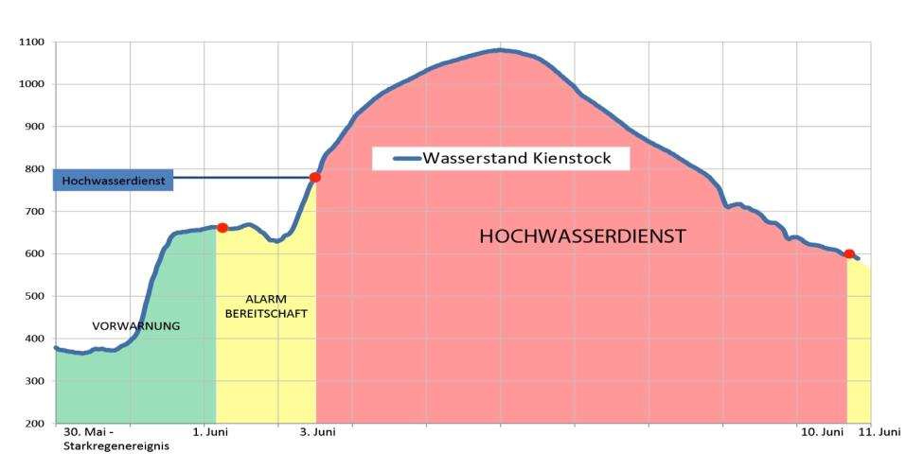
Flood emergency response
Flood Event June 2013 (HQ300)
WATER LEVEL KIENSTOCK (REFERENCE GAUGE)
INITIATION OF FLOOD EMERGENCY RESPONSE STAGE
FLOOD EMERGENCY RESPONSE
STAGE I & II
ALERT
ALERT
EARLY WARNING STAGE

Slide 40
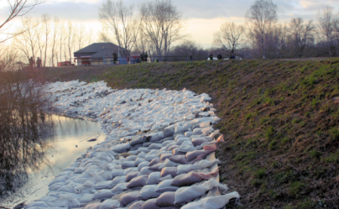
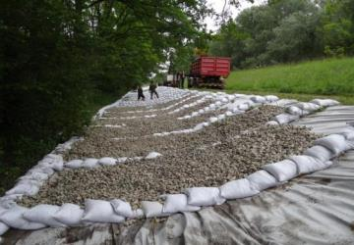
Flood emergency response
Defensive Measures
Sandbags
Mobile flood defense systems
Supported by local voluntary fire brigade and federal armed forces

Slide 41
Flood emergency response
 | “Normal operation” (in case of a flood) | Disaster
Responsibility | viadonau | Local authorities
Water level | Water level below design water level | Water level above design water level (HQ100)
Functional capability of flood protection facility | Facility is fully functional | Failure of essential facility component (i.e. dike breach)
Operation | Operator is able to control the situation with own forces | Additional forces required
On duty | viadonau Local voluntary fire brigade (upon request of operator) Experts upon request of viadonau (i.e. geotechnical) | Local authorities viadonau Local voluntary fire brigade (upon request of local authorities) Authorised experts Federal armed forces

Slide 42
Terminology
Dike crest
Level of design discharge Design water level
Freeboard
Berm
Maintenance path
water-side dike toe
Dike
land-side dike toe
MW
Impermeable layer (clay)
Aquifer

Slide 43
Drainage by surcharge
apply geomambrane
charge with permeable filling material
Goal: no sediment (fine material) erosion, no slope failure, dike remains structually stable

Slide 44
Drainage by surcharge
soaked dike with seepage surface line
rising groundwater
possible slip circle
apply geomembrane
apply sandbags first of all at the land-side dike toe
do not avoid water outlet !
WSP
Impermeable layer (clay)
Aquifer

Slide 45
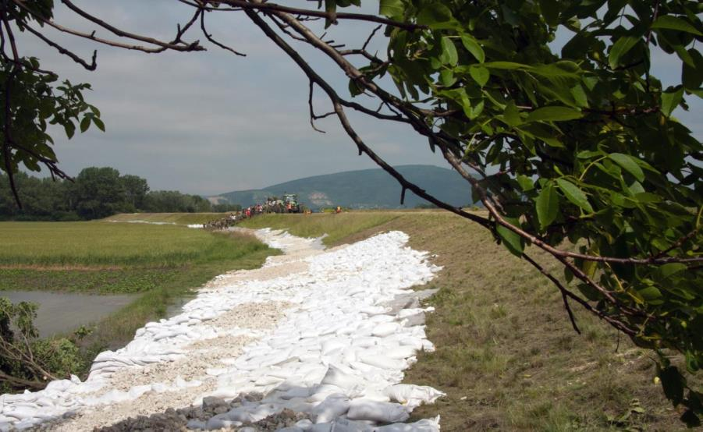

Slide 46
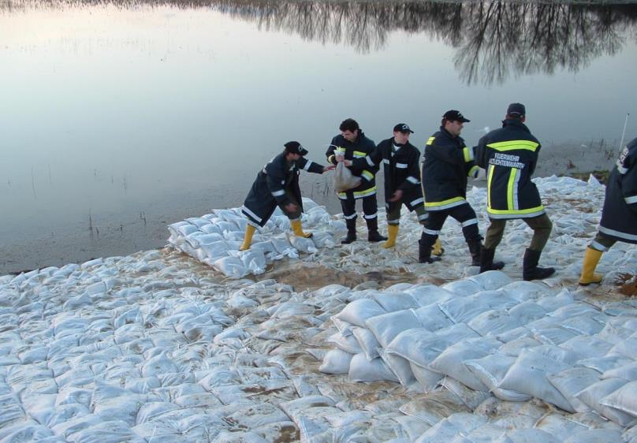

Slide 48
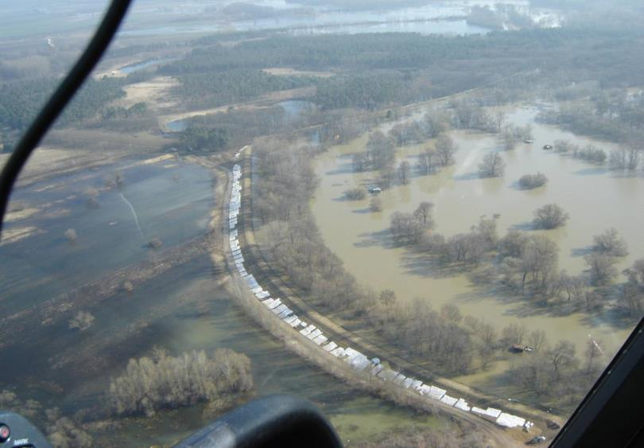

Slide 49
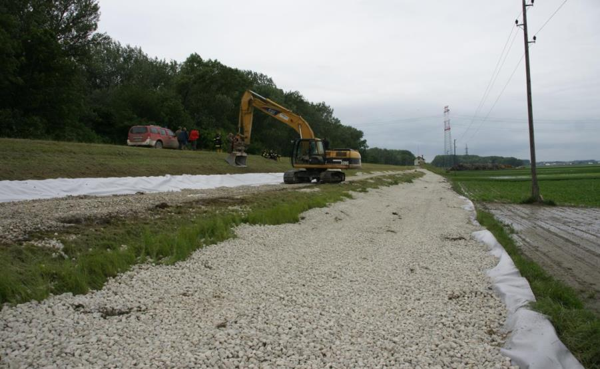

Slide 50
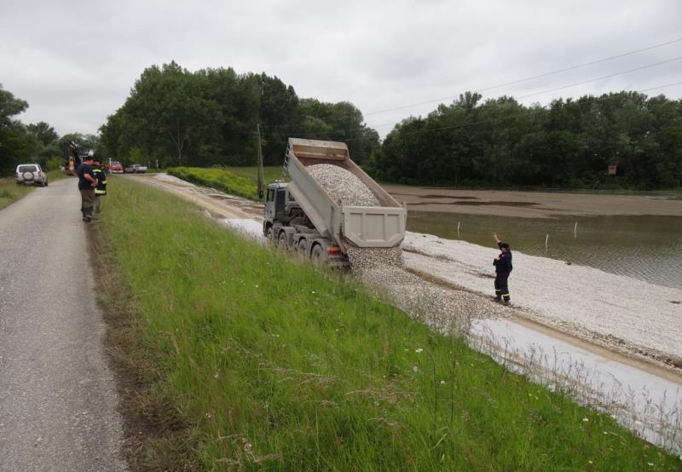

Slide 51
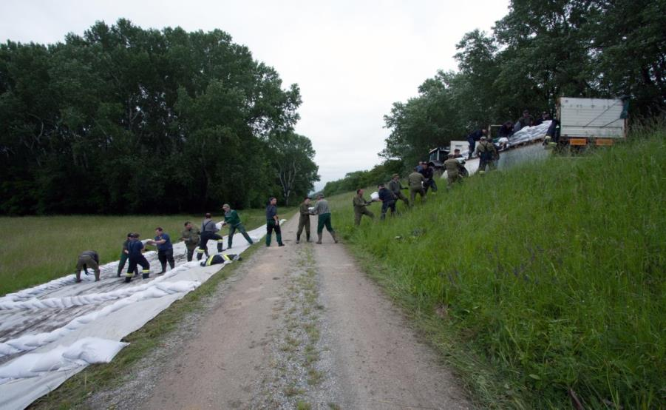

Slide 52
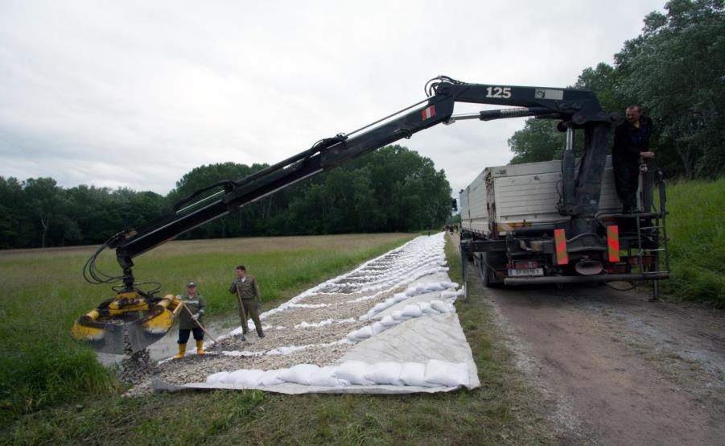

Slide 54
Rehabilitation of Flood Protection Facilities

Slide 55
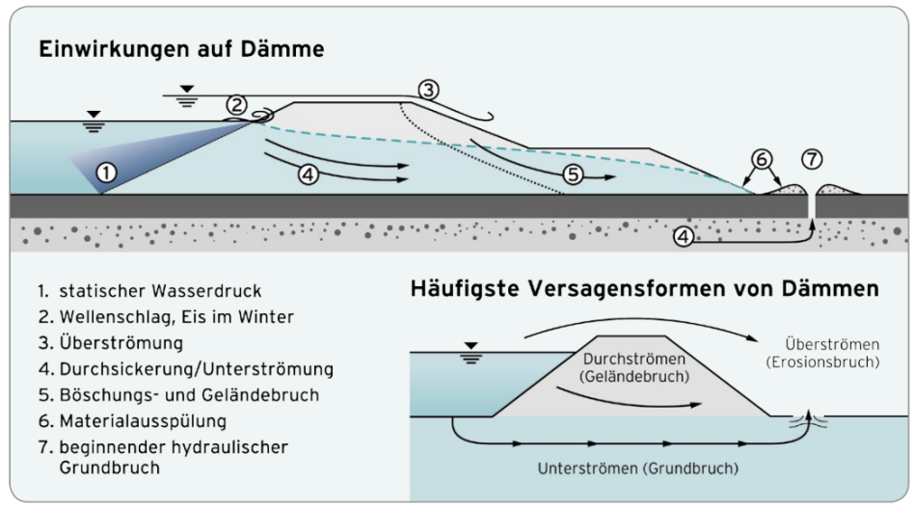
Failure mechanisms of dikes
Impact on dikes
Static water pressure
Wave impact, ice impact in winter
Overtopping
Seepage/Undercurrent
Slope failure
Erosion
Subsurface erosion
Most common failures of dikes
Overtopping
Seepage
Undercurrent

Slide 56
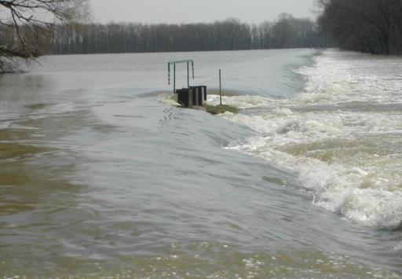
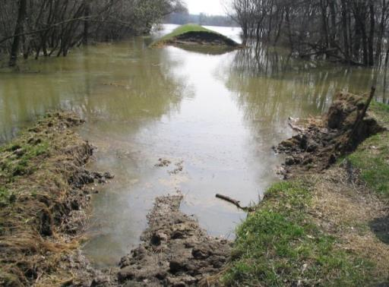
Failure mechanisms of dikes

Slide 57
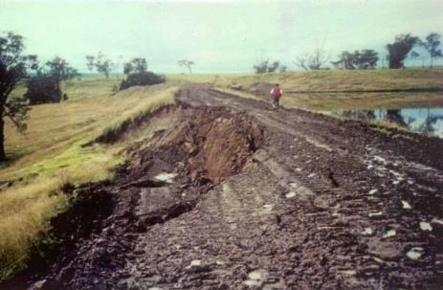
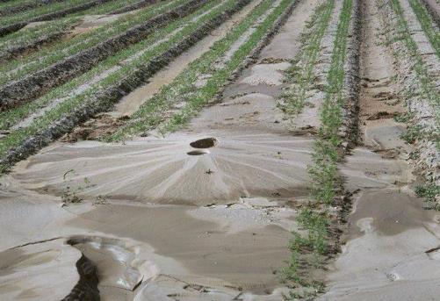
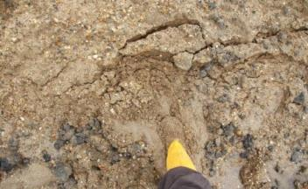
Failure mechanisms of dikes

Slide 58
Failure mechanisms of dikes

Slide 59
Rehabilitation measures
Technical measures to prevent damages/failures
Individual technical measures or combination of various measures
Implementation during construction of dike
Subsequent incorporation during rehabilitation of dike
Goal: Improvement of functionality and structural stability

Slide 60
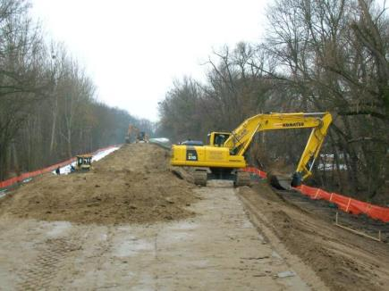
Construction process
Removal of the existing embankment
Removal of the existing embankment in short sections

Slide 61
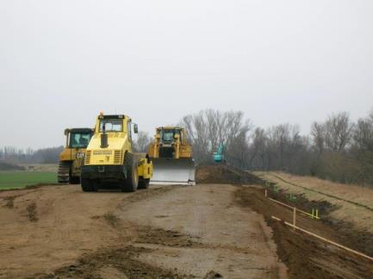
Construction process
Construction of new embankment
The new embankment is built up in compacted layers
Slopes are covered by a humus layer and re-cultivated

Slide 62
Drainage elements at base of the dike
Seeapage of water through the dike; during longer impoundment a seepage line is developed
Seepage line is releasing pressure in the drainage element, seepage water can exit at the base of the dike
No sediment (fine material) erosion, no slope failure, dike remains structually stable
WL
Drainage element
Impermeable layer (clay)
Aquifer

Slide 63
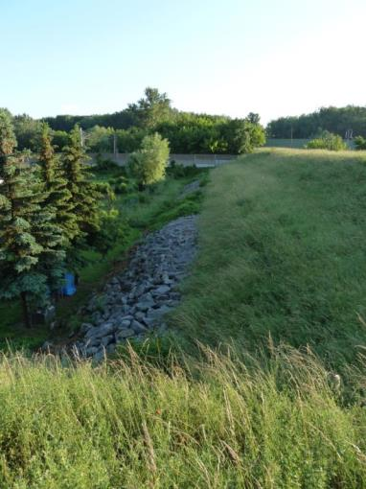
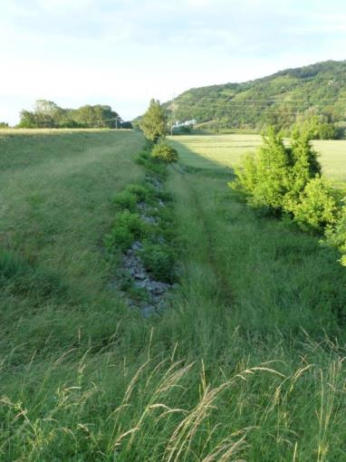
Drainage elements at base of the dike

Slide 64
Internal sealing
Seepage of water through the dike
Sealing (i.e. Diaphragm wall, Mixed-in-place wall, sheet piling) prevents further seapage
Seepage path is lengtened due to sealing, quantity of seaapage water is reduced
No slope failure, dike remains structually stable
WL
Sealing
Impermeable layer (clay)
Aquifer

Slide 65
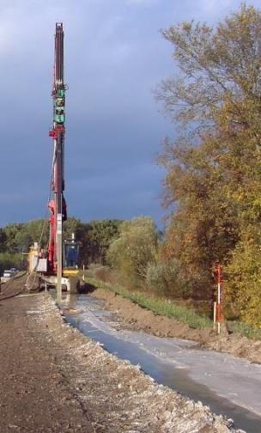
Construction process
Diaphragm wall
Only sealing function
Static function performed by the dike embankment
I-beam is vibrated into the ground; as the beam is withdrawn, the resulting cavity is filled with betonite slurry
Thickness approx. 8-12 cm

Slide 66
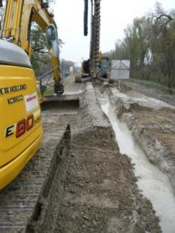
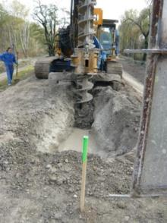
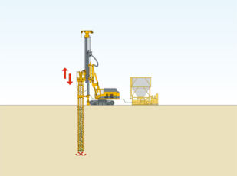
Construction process
Mixed-in-Place wall
Sealing function
Partial static function (main static function performed by the dike embankment)
Spiral is rotated into the ground, the soil is rearranged and the cavities are filled with suspension
Thickness: 40-50 cm

Slide 67
Pressure relief drainage
Aquifer is recharged by groundwater and infiltrating surface water
Uplift pressure is relieved by gravel pillars
Dike remains structually stable
WL
Pressure relief draiage
Impermeable layer (clay)
Aquifer

Slide 68
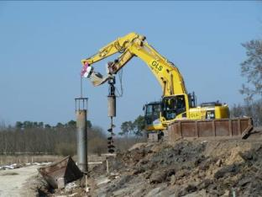
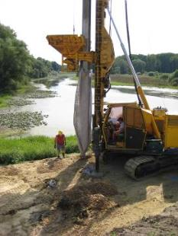
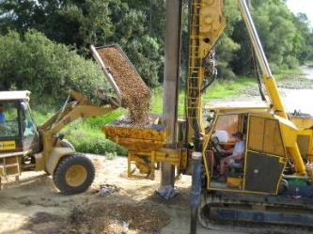
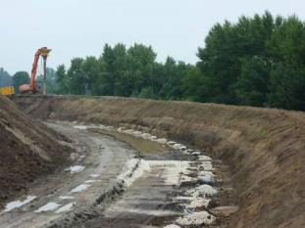
Construction process
Gravel pillars for relief drainage
Drainage effect achieved by gravel pillars wrapped in fleece
Method: drilling or pile-driven

Slide 69
Superimposed load filling
Aquifer is recharged by groundwater and infiltrating surface water
Weight of the superimposed load filling counteracts the uplift pressure of the groundwater
Dike remains structually stable
WL
Superimposed load filling
Impermeable layer (clay)
Aquifer

Slide 70
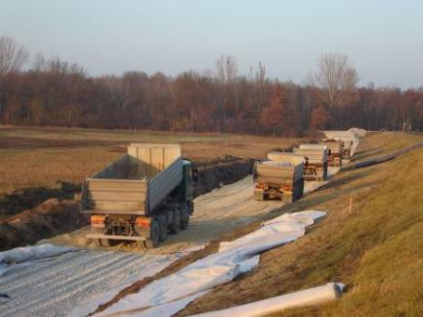
Construction process
Maintenance path
3m wide path
usually built at the land-side dike toe
in exceptional cases built along the dike crest
for maintenance and
to provide access to the dike in case of flooding (defensive measures)

Slide 71
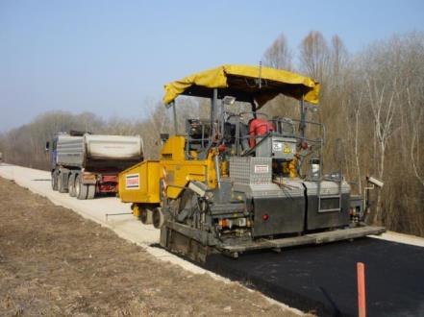
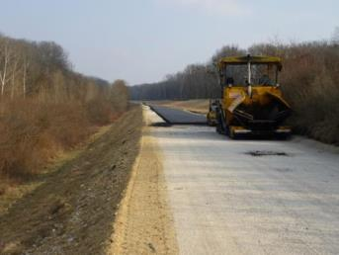
Construction process
Surface of dike crest
Gravel path
Asphalt (cycle path)

Slide 72
Construction process
Removal of the existing dike crest
Gravel pillars for pressure relief drainage at the dike base
If necessary: removal of the existing dike; new dike is built up in compacted layers to the level of design discharge
Permeable filling material
Maintenance path
Diaphragm wall/Mixed-in-Place wall
Dike crest
HW 100
Impermeable layer (clay)
Aquifer

Slide 73
Flood protection projects
 | Morava and lower Thaya | Danube
Client | Flood Protection Associations | Danube Flood Control Agency
Financing | bmvit, Federal state of Lower Austria, municipalities | bmvit, City of Vienna, Federal State of Lower Austria
Investment | approx. € 123 Mio. | approx. € 95.4 Mio.
Length | approx. 80 km | approx. 67 km
Protected population | approx. 18.000 individuals (in 10 municipalities) | approx. 30.000 individuals (in 12 municipalities)
Design discharge | HQ₁₀₀ + 70 cm freeboard | > HQ₁₀₀₀ (Q = 14.000 m³/s) + variable freeboard (0 – 50 cm)
Construction measures | Sealing: Diaphragm wall Relief drainage: Gravel pillars Protective strip surface: gravel Dike crest surface: gravel | Sealing: Mixed-in-Place wall Relief drainage: Gravel pillars Protective strip surface: grass Dike crest and maintanance path surface: gravel or asphalt (cycle track)
Construction period | 2006 – 2012 | 2017 - 2020

Slide 74
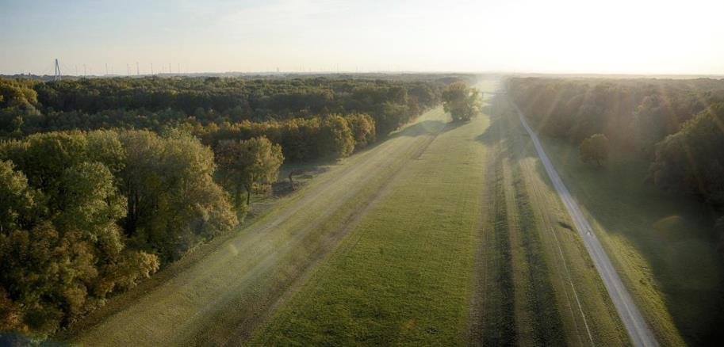
Rehabilitation of Flood Protection along the River Danube east of Vienna

Slide 75
Background
Provides flood protection for City of Vienna and for parts of Lower Austria east of Vienna
Design discharge: 14.000 m³/s (>HQ₁₀₀₀)
Construction of dike 120 years ago
Last rehabilitation in 1970ies (only certain sections of the dike)
Defensive measures during flood events (2002, 2013)
2d model: raising dike crest level necessary

Slide 76
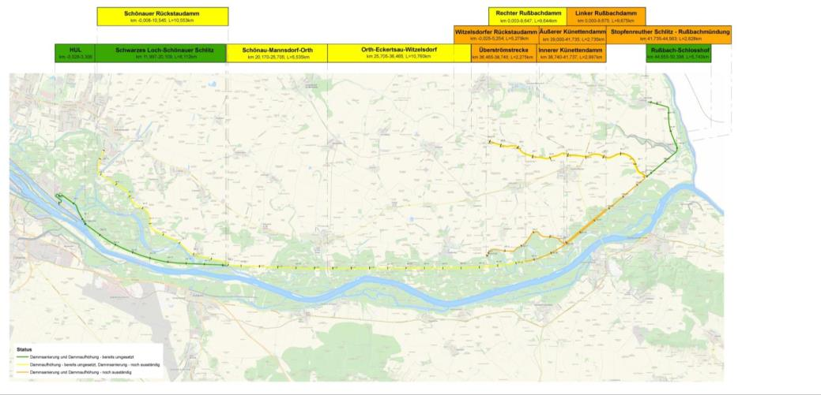
Flood protection system

Slide 77
Flood protection system
Video

Slide 81
Challenges
Permits
Water law
Conservation law
National park law
Forest law
Trans-border-system
Protected area (national park, Natura-2000, nature reserve, landscape conservation area)
Conflicting interests (agriculture, nature conservation, tourism)

Slide 82
Trans-border system
Discharge as per consent 1977
Discharge as per 2D-model
Morava (HQ₃₀)
1.040 m³/s
SK
13.200 m³/s
13.150 m³/s
280 m³/s
140 m³/s
800 m³/s
540 m³/s
13.200 m³/s
13.420 m³/s
12.920 m³/s
13.280 m³/s
PHHQ 14.000 m³/s
1.080 m³/s
720 m³/s
PHHQ 14.000 m³/s
Overflow section
Overflow starts at 12.000 m³/s

Slide 83
Environment protection
National park

Slide 84
Environment protection
Natura 2000 is a network of nature protection areas in the territory of the European Union.
It is made up of Special Areas of Conservation (SACs) and Special Protection Areas (SPAs) designated respectively under the Habitats Directive and Birds Directive.

Slide 85
Objects of protection
Dry grassland
Orchids
Amphibians
Reptiles
Birds

Slide 86
Dry grassland
Precious dry grass lands
Red-listed species
Habitat for snail, grasshopper, butterfly

Slide 87
Orchids
Red-listed species
Orchis militaris
Anacamptis morio
Neottinea ustulata

Slide 88
Butterflies

Slide 89
Dry grassland & Orchids

Slide 90
Orchids
Measures
Manual relocation of orchids

Slide 91
Forest
Measures
Preservation of precious trees
compensatory measures (i.e. forestation)

Slide 92
Amphibians and reptiles
Reptiles use dike as wintering grounds
Amphibians cross the dike to get to water bodies

Slide 93
Amphibians and reptiles
Measures
mobile seasonal fences for amphibians
Amphibians are caught in buckets, transferred by hand to other side of the dike

Slide 94
European pond terrapin
Red-listed species
Without measures construction only possible one month per year due to reproduction cycle

Slide 95
European pond terrapin
Measures
Construction ban during egg deposition (15.5.-15.7.)
3 types of protective measures: artificial hatching, cages, fences

Slide 96
Birds
sea eagle
black stork
honey buzzard
Measures
Identification of nests
Construction ban during sensitive periods of reproduction

Slide 97
Seeds
Measures
seeds are collected along the dike by hand
Re-cultivation of slopes with seeds that are adapted to the situation

Slide 98
Thank you for your attention!
Contact
Stefan Scheuringer Head of Flood Management T +43 50 4321-2603 stefan.scheuringer@viadonau.org Donau-City-Straße 1
1220 Vienna

